Slide 1
MODULE IV
Syntax directed translation:
Syntax directed definitions, Bottom- up evaluation of S-attributed definitions, L- attributed definitions, Top-down translation, Bottom-up evaluation of inherited attributes.
Type Checking :
Type systems, Specification of a simple type checker.
Notes:
lec05-syntaxdirected
January 4, 1980

Slide 2
COURSE OUTCOME
Design syntax directed translation schemes for a given context free grammar.
Notes:
lec05-syntaxdirected
January 4, 1980

Slide 3
Syntax-Directed Translation
Notes:
lec05-syntaxdirected
January 4, 1980

Slide 4
Syntax-Directed Translation
Grammar symbols are associated with attributes to associate information with the programming language constructs that they represent.
Values of these attributes are evaluated by the semantic rules associated with the production rules.
Evaluation of these semantic rules:
  may generate intermediate codes
  may put information into the symbol table
  may perform type checking
  may issue error messages
  may perform some other activities
  in fact, they may perform almost any activities.
An attribute may hold almost any thing.
  a string, a number, a memory location, a complex record.
Compiler Design
Notes:
lec05-syntaxdirected
January 4, 1980
lec05-syntaxdirected
January 4, 1980

Slide 5
Syntax-Directed Definitions and Translation Schemes
When we associate semantic rules with productions, we use two notations:
  Syntax-Directed Definitions
  Translation Schemes
Syntax-Directed Definitions:
  give high-level specifications for translations
  hide many implementation details such as order of evaluation of semantic actions.
  We associate a production rule with a set of semantic actions, and we do not say when they will be evaluated.
Translation Schemes:
  indicate the order of evaluation of semantic actions associated with a production rule.
  In other words, translation schemes give a little bit information about implementation details.
Compiler Design
Notes:
lec05-syntaxdirected
January 4, 1980
lec05-syntaxdirected
January 4, 1980

Slide 6
Syntax-Directed Definitions
A syntax-directed definition is a generalization of a context-free grammar in which:
  Each grammar symbol is associated with a set of attributes.
  This set of attributes for a grammar symbol is partitioned into two subsets called synthesized and inherited attributes of that grammar symbol.
  Each production rule is associated with a set of semantic rules.
Semantic rules set up dependencies between attributes which can be represented by a dependency graph.
This dependency graph determines the evaluation order of these semantic rules.
Evaluation of a semantic rule defines the value of an attribute. But a semantic rule may also have some side effects such as printing a value.
Compiler Design
Notes:
lec05-syntaxdirected
January 4, 1980
lec05-syntaxdirected
January 4, 1980

Slide 7
Annotated Parse Tree
A parse tree showing the values of attributes at each node is called an annotated parse tree.
The process of computing the attributes values at the nodes is called annotating (or decorating) of the parse tree.
Of course, the order of these computations depends on the dependency graph induced by the semantic rules.
Compiler Design
Notes:
lec05-syntaxdirected
January 4, 1980
lec05-syntaxdirected
January 4, 1980

Slide 8
Syntax-Directed Definition
In a syntax-directed definition, each production A→α is associated with a set of semantic rules of the form:
b=f(c₁,c₂,…,c_{n}),
where f is a function,
and b can be one of the following:
➔ b is a synthesized attribute of A and c₁,c₂,…,c_{n} are attributes of the grammar symbols in the production ( A→α ).
OR
➔ b is an inherited attribute of one of the grammar symbols in α (on the right side of the production), and c₁,c₂,…,c_{n} are attributes of the grammar symbols in the production ( A→α ).
Compiler Design
Notes:
lec05-syntaxdirected
January 4, 1980
lec05-syntaxdirected
January 4, 1980

Slide 9
Attribute Grammar
So, a semantic rule b=f (c₁,c₂,…,c_{n}) indicates that the attribute b depends on attributes c₁,c₂,…,c_{n}.
In a syntax-directed definition, a semantic rule may just evaluate a value of an attribute or it may have some side effects such as printing values.
An attribute grammar is a syntax-directed definition in which the functions in the semantic rules cannot have side effects (they can only evaluate values of attributes).
Compiler Design
Notes:
lec05-syntaxdirected
January 4, 1980
lec05-syntaxdirected
January 4, 1980

Slide 10
Syntax-Directed Definition – Example 1
Production Semantic Rules
L → E return print(E.val)‏
E → E₁ + T E.val = E₁.val + T.val
E → T E.val = T.val
T → T₁ * F T.val = T₁.val * F.val
T → F T.val = F.val
F → ( E ) F.val = E.val
F → digit F.val = digit.lexval
Symbols E, T, and F are associated with a synthesized attribute val.
The token digit has a synthesized attribute lexval (it is assumed that it is evaluated by the lexical analyzer).
Compiler Design
Notes:
lec05-syntaxdirected
January 4, 1980
lec05-syntaxdirected
January 4, 1980

Slide 11
Annotated Parse Tree -- Example
Input: 5+3*4
L
E.val=17 return
E.val=5 + T.val=12
T.val=5 T.val=3 * F.val=4
F.val=5 F.val=3 digit.lexval=4
digit.lexval=5 digit.lexval=3
Compiler Design
Notes:
lec05-syntaxdirected
January 4, 1980
lec05-syntaxdirected
January 4, 1980

Slide 12
Dependency Graph
Input: 5+3*4
L
E.val=17
E.val=5 T.val=12
T.val=5 T.val=3 F.val=4
F.val=5 F.val=3 digit.lexval=4
digit.lexval=5 digit.lexval=3
Compiler Design
Notes:
lec05-syntaxdirected
January 4, 1980
lec05-syntaxdirected
January 4, 1980

Slide 13
Syntax-Directed Definition – Example2
Production Semantic Rules
E → E₁ + T E.loc=newtemp(), E.code = E₁.code || T.code || add E₁.loc,T.loc,E.loc
E → T E.loc = T.loc, E.code=T.code
T → T₁ * F T.loc=newtemp(), T.code = T₁.code || F.code || mult T₁.loc,F.loc,T.loc
T → F T.loc = F.loc, T.code=F.code
F → ( E ) F.loc = E.loc, F.code=E.code
F → id F.loc = id.name, F.code=“”
Symbols E, T, and F are associated with synthesized attributes loc and code.
The token id has a synthesized attribute name (it is assumed that it is evaluated by the lexical analyzer).
It is assumed that || is the string concatenation operator.
Compiler Design
Notes:
lec05-syntaxdirected
January 4, 1980
lec05-syntaxdirected
January 4, 1980

Slide 14
Syntax-Directed Definition – Inherited Attributes
Production Semantic Rules
D → T L L.in = T.type
T → int T.type = integer
T → real T.type = real
L → L₁ id L₁.in = L.in, addtype(id.entry, L.in)‏
L → id addtype(id.entry, L.in)‏
Symbol T is associated with a synthesized attribute type.
Symbol L is associated with an inherited attribute in.
Compiler Design
Notes:
lec05-syntaxdirected
January 4, 1980
lec05-syntaxdirected
January 4, 1980

Slide 15
A Dependency Graph – Inherited Attributes
Input: real p q
D L.in=real
T L T.type=real L₁.in=real addtype(q,real)‏
real L id addtype(p,real) id.entry=q
id id.entry=p
parse tree dependency graph
Compiler Design
Notes:
lec05-syntaxdirected
January 4, 1980
lec05-syntaxdirected
January 4, 1980

Slide 16
S-Attributed Definitions
Syntax-directed definitions are used to specify syntax-directed translations.
To create a translator for an arbitrary syntax-directed definition can be difficult.
We would like to evaluate the semantic rules during parsing (i.e. in a single pass, we will parse and we will also evaluate semantic rules during the parsing).
We will look at two sub-classes of the syntax-directed definitions:
  S-Attributed Definitions: only synthesized attributes used in the syntax-directed definitions.
  L-Attributed Definitions: in addition to synthesized attributes, we may also use inherited attributes in a restricted fashion.
Implementations of S-attributed Definitions are a little bit easier than implementations of L-Attributed Definitions.
Compiler Design
Notes:
lec05-syntaxdirected
January 4, 1980
lec05-syntaxdirected
January 4, 1980

Slide 17
Syntax Trees
(Abstract) Syntax Trees:
  Condensed form of parse tree.
  Useful for representing language constructs.
  Operators and keywords appear as internal nodes.
Syntax-directed translation can be based on syntax trees as well as parse trees.
Compiler Design
Notes:
lec05-syntaxdirected
January 4, 1980

Slide 18
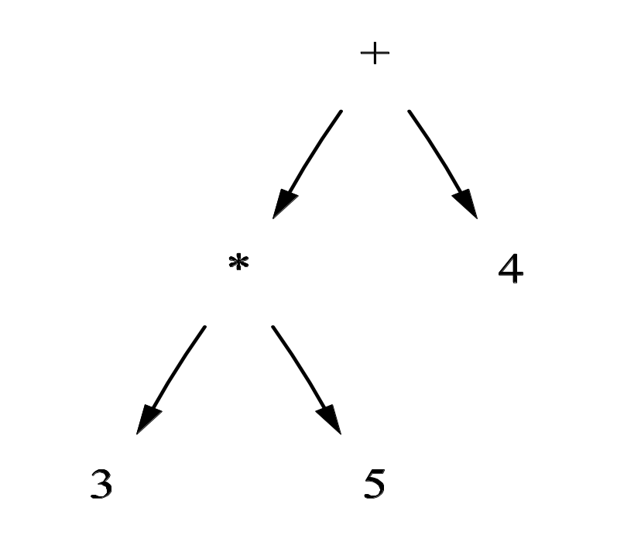
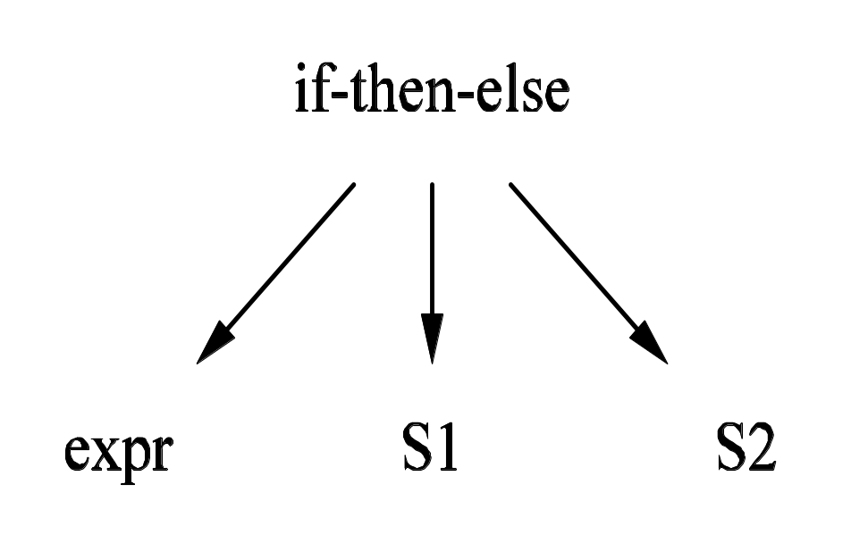
Syntax Tree Examples
Compiler Design
Notes:
lec05-syntaxdirected
January 4, 1980

Slide 19
Implementing Syntax Trees
Each node can be represented by a record with several fields.
Example: node representing an operator used in an expression:
  One field indicates the operator and others point to records for nodes representing operands.
  The operator is referred to as the “label” of the node.
If being used for translation, records can have additional fields for attributes.
Compiler Design
Notes:
lec05-syntaxdirected
January 4, 1980

Slide 20
Syntax Trees for Expressions
Functions will create nodes for the syntax tree
  mknode (op, left, right) – creates an operator node with label op and pointers left and right which point to operand nodes
  mkleaf(id, entry) – creates an identifier node with label id and a pointer to the appropriate symbol table entry
  Mkleaf(num, val) – creates a number node with label num and value val
Each function returns pointer to created node
Compiler Design
Notes:
lec05-syntaxdirected
January 4, 1980

Slide 21
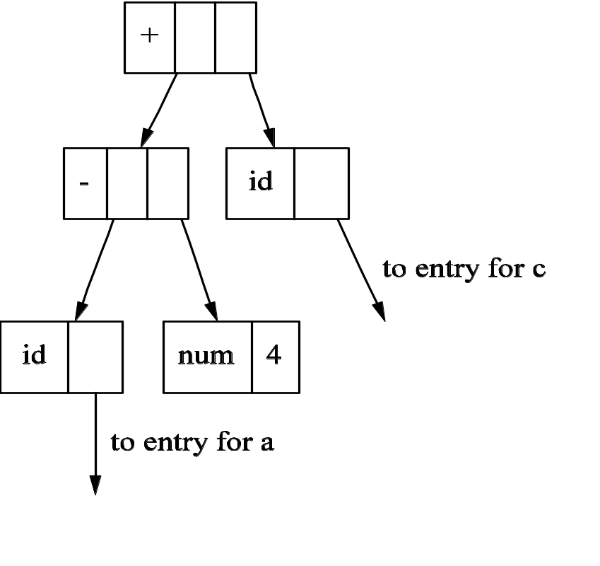
Example: a - 4 + c
p₁ := mkleaf(id, p_{a});
P₂ := mkleaf(num, 4);
p₃ := mknode('-', p₁, p₂);
p₄ := mkleaf(id, p_{c});
p₅ := mknode('+', p₃, p₄);
Compiler Design
Notes:
lec05-syntaxdirected
January 4, 1980

Slide 22
Constructing Syntax Trees for an Expression
Production Semantic Rules
E → E₁ + T E.nptr := mknode('+', E₁.nptr, T.nptr)
E → E₁ - T E.nptr := mknode('-', E₁.nptr, T.nptr)
E → T E.nptr := T.nptr
T → ( E ) T.nptr := E.nptr
T → id T.nptr := mkleaf (id, id.entry)
T → num T.nptr := mkleaf (num, num.value)
Compiler Design
Notes:
lec05-syntaxdirected
January 4, 1980

Slide 23
Directed Acyclic Graphs
Called a dag for short.
Convenient for representing expressions.
As with syntax trees:
  Every subexpression will be represented by a node.
  Interior nodes represent operators, children represent operands.
Unlike syntax trees, nodes may have more than one parent.
Can be created automatically.
Compiler Design
Notes:
lec05-syntaxdirected
January 4, 1980

Slide 24
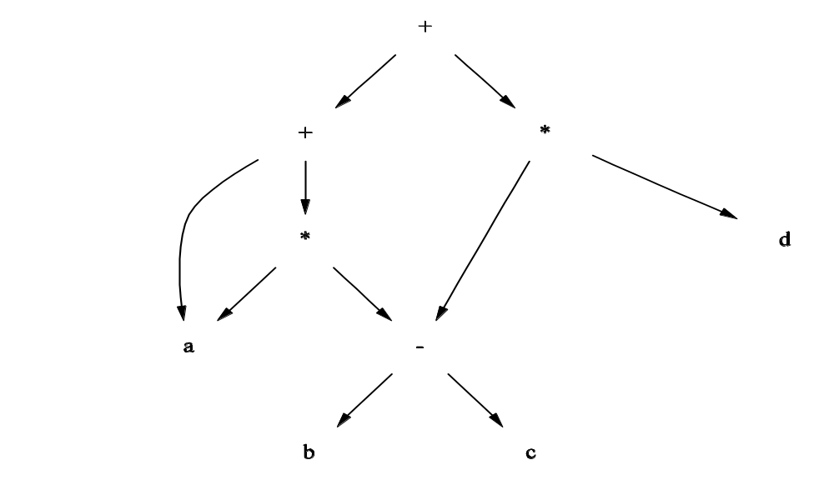
Example: a + a * (b – c) + (b – c) * d
Compiler Design
Notes:
lec05-syntaxdirected
January 4, 1980

Slide 25
Bottom-Up Evaluation of S-Attributed Definitions
We put the values of the synthesized attributes of the grammar symbols into a parallel stack.
  When an entry of the parser stack holds a grammar symbol X (terminal or non-terminal), the corresponding entry in the parallel stack will hold the synthesized attribute(s) of the symbol X.
We evaluate the values of the attributes during reductions.
A → XYZ A.a=f(X.x,Y.y,Z.z) where all attributes are synthesized.
stack parallel-stack
top →
➔ top →
Z
Z.z
Y
Y.y
X
X.x
A
A.a
.
.
.
.
Compiler Design
Notes:
lec05-syntaxdirected
January 4, 1980
lec05-syntaxdirected
January 4, 1980

Slide 26
Bottom-Up Eval. of S-Attributed Definitions (cont.)‏
Production Semantic Rules
L → E return print(val[top-1])‏
E → E₁ + T val[ntop] = val[top-2] + val[top]
E → T
T → T₁ * F val[ntop] = val[top-2] * val[top]
T → F
F → ( E ) val[ntop] = val[top-1]
F → digit
At each shift of digit, we also push digit.lexval into val-stack.
At all other shifts, we do not put anything into val-stack because other terminals do not have attributes (but we increment the stack pointer for val-stack).
Compiler Design
Notes:
lec05-syntaxdirected
January 4, 1980
lec05-syntaxdirected
January 4, 1980

Slide 27
Canonical LR(0) Collection for The Grammar
L
I₁:
I₀:
L’→.L
L →.Er
E →.E+T
E →.T
T →.T*F
T →.F
F →.(E)‏
F →.d
L’→L.
L →E.r
E →E.+T
E →T.
T →T.*F
T →F.
F → (.E)‏
E →.E+T
E →.T
T →.T*F
T →.F
F →.(E)‏
F →.d
F →d.
I₇:
L →Er.
E →E+.T
T →.T*F
T →.F
F →.(E)‏
F →.d
T →T*.F
F →.(E)‏
F →.d
F →(E.)‏
E →E.+T
I₁₁:
E →E+T.
T →T.*F
T →T*F.
F →(E).
*
9
r
T
E
I₂:
+
I₈:
F
4
(
5
d
T
I₃:
6
*
F
I₄:
I₉:
F
(
I₁₂:
I₅:
(
E
5
d
6
T
I₁₀:
)‏
I₁₃:
3
+
F
4
8
(
d
I₆:
5
d
6
Compiler Design
Notes:
lec05-syntaxdirected
January 4, 1980
lec05-syntaxdirected
January 4, 1980

Slide 28
Bottom-Up Evaluation -- Example
At each shift of digit, we also push digit.lexval into val-stack.
stack val-stack input action semantic rule
0 5+3*4r s 6 d.lexval(5) into val-stack
0d 6 5 +3*4r F→d F.val=d.lexval – do nothing
0F4 5 +3*4r T→F T.val=F.val – do nothing
0T3 5 +3*4r E→T E.val=T.val – do nothing
0E2 5 +3*4r s 8 push empty slot into val-stack
0E2+8 5- 3*4r s 6 d.lexval(3) into val-stack
0E2+8d6 5-3 *4r F→d F.val=d.lexval – do nothing
0E2+8F4 5-3 *4r T→F T.val=F.val – do nothing
0E2+8T11 5-3 *4r s 9 push empty slot into val-stack
0E2+8T11*9 5-3- 4r s 6 d.lexval(4) into val-stack
0E2+8T11*9d 6 5-3-4 r F→d F.val=d.lexval – do nothing
0E2+8T11*9F12 5-3-4 r T→T*F T.val=T₁.val*F.val
0E2+8T11 5-12 r E→E+T E.val=E₁.val*T.val
0E2 17 r s7 push empty slot into val-stack
0E2r7 17- $ L→Er print(17), pop empty slot from val-stack
0L1 17 $ acc
Compiler Design
Notes:
lec05-syntaxdirected
January 4, 1980
lec05-syntaxdirected
January 4, 1980

Slide 29
Top-Down Evaluation (of S-Attributed Definitions)‏
Productions Semantic Rules
A → B print(B.n0), print(B.n1)‏
B → 0 B₁ B.n0=B₁.n0+1, B.n1=B₁.n1
B → 1 B₁ B.n0=B₁.n0, B.n1=B₁.n1+1
B → ε B.n0=0, B.n1=0
Above production rule identifies a binary number A and print the number of 0s and 1s (where B has two synthesized attributes (n0 and n1)).
Compiler Design
Notes:
lec05-syntaxdirected
January 4, 1980
lec05-syntaxdirected
January 4, 1980

Slide 30
Top-Down Parser‏
Remember that: In a recursive predicate parser, each non-terminal corresponds to a procedure.
RECURSIVE PREDICATE PARSER
procedure A() {
call B(); A → B
}
procedure B() {
if (currtoken=0) { call B(); } B → 0 B
else if (currtoken=1) { call B(); } B → 1 B
else if (currtoken=$) {} // $ is end-marker B → ε
else error(“unexpected token”);
}
Compiler Design
Notes:
lec05-syntaxdirected
January 4, 1980
lec05-syntaxdirected
January 4, 1980

Slide 31
Top-Down Evaluation (of S-Attributed Definitions)‏
procedure A() {
int n0,n1; Synthesized attributes of non-terminal B
call B(&n0,&n1); are the output parameters of procedure B.
print(n0); print(n1);
} All the semantic rules can be evaluated
procedure B(int *n0, int *n1) { at the end of parsing of production rules
if (currtoken=0)
{int a,b; call B(&a,&b); *n0=a+1; *n1=b;}
else if (currtoken=1)
{ int a,b; call B(&a,&b); *n0=a; *n1=b+1; }
else if (currtoken=$) {*n0=0; *n1=0; } // $ is end-marker
else error(“unexpected token”);
}
Compiler Design
Notes:
lec05-syntaxdirected
January 4, 1980
lec05-syntaxdirected
January 4, 1980

Slide 32
L-Attributed Definitions
S-Attributed Definitions can be efficiently implemented.
We are looking for a larger (larger than S-Attributed Definitions) subset of syntax-directed definitions which can be efficiently evaluated.
➔ L-Attributed Definitions
L-Attributed Definitions can always be evaluated by the depth first visit of the parse tree.
This means that they can also be evaluated during the parsing.
Compiler Design
Notes:
lec05-syntaxdirected
January 4, 1980
lec05-syntaxdirected
January 4, 1980

Slide 33
L-Attributed Definitions
A syntax-directed definition is L-attributed if each inherited attribute of X_{j}, where 1≤j≤n, on the right side of A → X₁X₂...X_{n} depends only on:
  The attributes of the symbols X₁,...,X_{j-1} to the left of X_{j} in the production and
  the inherited attribute of A
Every S-attributed definition is L-attributed, the restrictions only apply to the inherited attributes (not to synthesized attributes).
Compiler Design
Notes:
lec05-syntaxdirected
January 4, 1980
lec05-syntaxdirected
January 4, 1980

Slide 34
A Definition which is NOT L-Attributed
Productions Semantic Rules
A → L M L.in=l(A.in), M.in=m(L.s), A.s=f(M.s)‏
A → Q R R.in=r(A.in), Q.in=q(R.s), A.s=f(Q.s)‏
This syntax-directed definition is not L-attributed because the semantic rule Q.in=q(R.s) violates the restrictions of L-attributed definitions.
When Q.in must be evaluated before we enter to Q because it is an inherited attribute.
But the value of Q.in depends on R.s which will be available after we return from R. So, we are not be able to evaluate the value of Q.in before we enter to Q.
Compiler Design
Notes:
lec05-syntaxdirected
January 4, 1980
lec05-syntaxdirected
January 4, 1980

Slide 35
Translation Schemes
In a syntax-directed definition, we do not say anything about the evaluation times of the semantic rules (when the semantic rules associated with a production should be evaluated?).
A translation scheme is a context-free grammar in which:
  attributes are associated with the grammar symbols and
  semantic actions enclosed between braces {} are inserted within the right sides of productions.
Ex: A → { ... } X { ... } Y { ... }
Semantic Actions
Compiler Design
Notes:
lec05-syntaxdirected
January 4, 1980
lec05-syntaxdirected
January 4, 1980

Slide 36
Translation Schemes
When designing a translation scheme, some restrictions should be observed to ensure that an attribute value is available when a semantic action refers to that attribute.
These restrictions (motivated by L-attributed definitions) ensure that a semantic action does not refer to an attribute that has not yet computed.
In translation schemes, we use semantic action terminology instead of semantic rule terminology used in syntax-directed definitions.
The position of the semantic action on the right side indicates when that semantic action will be evaluated.
Compiler Design
Notes:
lec05-syntaxdirected
January 4, 1980
lec05-syntaxdirected
January 4, 1980

Slide 37
Translation Schemes for S-attributed Definitions
If our syntax-directed definition is S-attributed, the construction of the corresponding translation scheme will be simple.
Each associated semantic rule in a S-attributed syntax-directed definition will be inserted as a semantic action into the end of the right side of the associated production.
Production Semantic Rule
E → E₁ + T E.val = E₁.val + T.val ➔ a production of a syntax directed
  definition
E → E₁ + T { E.val = E₁.val + T.val } ➔ the production of the corresponding
translation scheme
Compiler Design
Notes:
lec05-syntaxdirected
January 4, 1980
lec05-syntaxdirected
January 4, 1980

Slide 38
A Translation Scheme Example
A simple translation scheme that converts infix expressions to the corresponding postfix expressions.
E → T R
R → + T { print(“+”) } R₁
R → ε
T → id { print(id.name) }
a+b+c ➔ ab+c+
infix expression postfix expression
Compiler Design
Notes:
lec05-syntaxdirected
January 4, 1980
lec05-syntaxdirected
January 4, 1980

Slide 39
A Translation Scheme Example (cont.)‏
E
T R
id {print(“a”)} + T {print(“+”)} R
id {print(“b”)} + T {print(“+”)} R
id {print(“c”)} ε
The depth first traversal of the parse tree (executing the semantic actions in that order)‏
will produce the postfix representation of the infix expression.
Compiler Design
Notes:
lec05-syntaxdirected
January 4, 1980
lec05-syntaxdirected
January 4, 1980

Slide 40
Inherited Attributes in Translation Schemes
If a translation scheme has to contain both synthesized and inherited attributes, we have to observe the following rules:
  An inherited attribute of a symbol on the right side of a production must be computed in a semantic action before that symbol.
  A semantic action must not refer to a synthesized attribute of a symbol to the right of that semantic action.
  A synthesized attribute for the non-terminal on the left can only be computed after all attributes it references have been computed (we normally put this semantic action at the end of the right side of the production).
With a L-attributed syntax-directed definition, it is always possible to construct a corresponding translation scheme which satisfies these three conditions (This may not be possible for a general syntax-directed translation).
Compiler Design
Notes:
lec05-syntaxdirected
January 4, 1980
lec05-syntaxdirected
January 4, 1980

Slide 41
Top-Down Translation
We will look at the implementation of L-attributed definitions during predictive parsing.
Instead of the syntax-directed translations, we will work with translation schemes.
We will see how to evaluate inherited attributes (in L-attributed definitions) during recursive predictive parsing.
We will also look at what happens to attributes during the left-recursion elimination in the left-recursive grammars.
Compiler Design
Notes:
lec05-syntaxdirected
January 4, 1980
lec05-syntaxdirected
January 4, 1980

Slide 42
A Translation Scheme with Inherited Attributes
D → T id { addtype(id.entry,T.type), L.in = T.type } L
T → int { T.type = integer }
T → real { T.type = real }
L → id { addtype(id.entry,L.in), L₁.in = L.in } L₁
L → ε
This is a translation scheme for an L-attributed definitions (Variable declaration).
Compiler Design
Notes:
lec05-syntaxdirected
January 4, 1980
lec05-syntaxdirected
January 4, 1980

Slide 43
Predictive Parsing (of Inherited Attributes)‏
procedure D( )
{
int Ttype, Lin, identry;
call T(&Ttype);
consume(id,&identry);
addtype(identry,Ttype);
Lin=Ttype;
call L(Lin); a synthesized attribute (an output parameter)‏
}
procedure T(int *Ttype)
{
if (currtoken is int)
{ consume(int); *Ttype=TYPEINT; }
else if (currtoken is real)
{ consume(real); *Ttype=TYPEREAL; }
else { error(“unexpected type”); } ‏
}
Compiler Design
Notes:
lec05-syntaxdirected
January 4, 1980
lec05-syntaxdirected
January 4, 1980

Slide 44
Predictive Parsing (of Inherited Attributes) (Contd...)‏
an inherited attribute (an input parameter)‏
procedure L(int Lin)
{
if (currtoken is id)
{ int L1in, identry;
consume(id, &identry);
addtype(identry, Lin);
L1in=Lin;
call L(L1in); }
else if (currtoken is endmarker)
{ }
else { error(“unexpected token”); }
}
Compiler Design
Notes:
lec05-syntaxdirected
January 4, 1980
lec05-syntaxdirected
January 4, 1980

Slide 45
Eliminating Left Recursion from Translation Scheme
A translation scheme with a left recursive grammar.
E → E₁ + T { E.val = E₁.val + T.val }
E → T { E.val = T.val }
T → T₁ * F { T.val = T₁.val * F.val }
T → F { T.val = F.val }
F → ( E ) { F.val = E.val }
F → digit { F.val = digit.lexval }
When we eliminate the left recursion from the grammar (to get a suitable grammar for the top-down parsing) we also have to change semantic actions.
Compiler Design
Notes:
lec05-syntaxdirected
January 4, 1980
lec05-syntaxdirected
January 4, 1980

Slide 46
Eliminating Left Recursion (cont.)‏
inherited attribute synthesized attribute
E → T { E'.in=T.val } E' { E.val=E'.syn }
E' → + T { E'₁.in=E'.in+T.val } E'₁ { E'.syn = E'₁.syn}
E' → ε { E'.syn = E'.in }
T → F { T'.in=F.val } T' { T.val=T'.syn }
T' → * F { T'₁.in=T'.in*F.val } T'₁ { T'.syn = T'₁.syn}
T' → ε { T'.syn = T'.in }
F → ( E ) { F.val = E.val }
F → digit { F.val = digit.lexval }
Compiler Design
Notes:
lec05-syntaxdirected
January 4, 1980
lec05-syntaxdirected
January 4, 1980

Slide 47
Eliminating Left Recursion (in general)‏
A → A₁ Y { A.a = g(A₁.a,Y.y) } a left recursive grammar with
A → X { A.a=f(X.x) } synthesized attributes (a,y,x).
⬇ eliminate left recursion
inherited attribute of the new non-terminal
synthesized attribute of the new non-terminal
A → X { R.in=f(X.x) } R { A.a=R.syn }
R → Y { R₁.in=g(R.in,Y.y) } R₁ { R.syn = R₁.syn}
R → ε { R.syn = R.in }
Compiler Design
Notes:
lec05-syntaxdirected
January 4, 1980
lec05-syntaxdirected
January 4, 1980

Slide 48
Evaluating attributes
A parse tree of left recursive grammar
A Y A.a=g(f(X.x),Y.y)
parse tree of non-left-recursive grammar
X X.x=f(X.x) A
X R.in=f(X.x) R A.a=g(f(X.x,Y.y)
Y R₁.in=g(f(X.x),Y.y) R₁ R.syn=g(f(X.x),Y.y)
ε R₁.syn=g(f(X.x),Y.y)
Compiler Design
Notes:
lec05-syntaxdirected
January 4, 1980
lec05-syntaxdirected
January 4, 1980

Slide 49
Translation Scheme - Intermediate Code Generation
E → T { E'.in=T.loc } E' { E.loc=E'.loc }
E' → + T { E'₁.in=newtemp(); emit(add,E'.in,T.loc,E'₁.in) }
E'₁ { E'.loc = E'₁.loc}
E' → ε { E'.loc = E'.in }
T → F { T'.in=F.loc } T' { T.loc=T'.loc }
T' → * F { T'₁.in=newtemp(); emit(mult,T'.in,F.loc, T'₁.in) }
T'₁ { T'.loc = T'₁.loc}
T' → ε { T'.loc = T'.in }
F → ( E ) { F.loc = E.loc }
F → id { F.loc = id.name }
Compiler Design
Notes:
lec05-syntaxdirected
January 4, 1980
lec05-syntaxdirected
January 4, 1980

Slide 50
Predictive Parsing – Intermediate Code Generation
procedure E(char **Eloc)
{
char *E'in, *Tloc, *E'loc;
call T(&Tloc); E'.in=Tloc;
call E'(E'in,&E'loc);
*Eloc=E'loc;
}
procedure E'(char *E'in, char **E'loc)
{
if (currtok is +)
{ char *E'1in, *Tloc, *E'1loc;
consume(+);
call T(&Tloc);
E'1in=newtemp();
emit(“add”,E'in,Tloc,E'1in);
call E'(E'1in,&E'1loc);
*E'loc=E'1loc;
}
else { *E'loc = E'in }
}
Compiler Design
Notes:
lec05-syntaxdirected
January 4, 1980
lec05-syntaxdirected
January 4, 1980

Slide 51
Predictive Parsing (cont.)‏
procedure T(char **Tloc)
{
char *T'in, *Floc, *T'loc;
call F(&Floc);
T'in=Floc;
call T'(T'in,&T'loc);
*Tloc=T'loc;
}
procedure T'(char *T'in, char **T'loc) {
if (currtok is *)
{ char *T'1in, *Floc, *T'1loc;
consume(+);
call F(&Floc);
T'1in=newtemp();
emit(“mult”,T'in,Floc,T'1in);
call T'(T'1in,&T'1loc); T'loc=T'1loc;
}
else { *T'loc = T'in }
}
Compiler Design
Notes:
lec05-syntaxdirected
January 4, 1980
lec05-syntaxdirected
January 4, 1980

Slide 52
Predictive Parsing (cont.)‏
procedure F(char **Floc)
{
if (currtok is “(“)
{ char *Eloc;
consume(“(“);
call E(&Eloc);
consume(“)”);
*Floc=Eloc }
else
{ char *idname;
consume(id,&idname);
*Floc=idname }
}
Compiler Design
Notes:
lec05-syntaxdirected
January 4, 1980
lec05-syntaxdirected
January 4, 1980

Slide 53
Bottom-Up Evaluation of Inherited Attributes
Using a top-down translation scheme, we can implement any L-attributed definition based on a LL(1) grammar.
Using a bottom-up translation scheme, we can also implement any L-attributed definition based on a LL(1) grammar (each LL(1) grammar is also an LR(1) grammar).
In addition to the L-attributed definitions based on LL(1) grammars, we can implement some of L-attributed definitions based on LR(1) grammars (not all of them) using the bottom-up translation scheme.
Compiler Design
Notes:
lec05-syntaxdirected
January 4, 1980
lec05-syntaxdirected
January 4, 1980

Slide 54
Removing Embedding Semantic Actions
In bottom-up evaluation scheme, the semantic actions are evaluated during the reductions.
During the bottom-up evaluation of S-attributed definitions, we have a parallel stack to hold synthesized attributes.
Problem: where are we going to hold inherited attributes?
A Solution:
  We will convert our grammar to an equivalent grammar to guarantee to the followings.
  All embedding semantic actions in our translation scheme will be moved into the end of the production rules.
  All inherited attributes will be copied into the synthesized attributes (most of the time synthesized attributes of new non-terminals).
  Thus we will be evaluate all semantic actions during reductions, and we find a place to store an inherited attribute.
Compiler Design
Notes:
lec05-syntaxdirected
January 4, 1980
lec05-syntaxdirected
January 4, 1980

Slide 55
Removing Embedding Semantic Actions
To transform our translation scheme into an equivalent translation scheme:
Remove an embedding semantic action S_{i}, put new a non-terminal M_{i} instead of that semantic action.
Put that semantic action S_{i} into the end of a new production rule M_{i}→ε for that non-terminal M_{i}.
That semantic action S_{i} will be evaluated when this new production rule is reduced.
The evaluation order of the semantic rules are not changed by this transformation.
Compiler Design
Notes:
lec05-syntaxdirected
January 4, 1980
lec05-syntaxdirected
January 4, 1980

Slide 56
Removing Embedding Semantic Actions
A→ {S₁} X₁ {S₂} X₂ ... {S_{n}} X_{n}
⇓ remove embedding semantic actions
A→ M₁ X₁ M₂ X₂ ... M_{n} X_{n}
M₁→ε {S₁}
M₂→ε {S₂}
.
.
M_{n}→ε {S_{n}}
Compiler Design
Notes:
lec05-syntaxdirected
January 4, 1980
lec05-syntaxdirected
January 4, 1980

Slide 57
Removing Embedding Semantic Actions
E → T R
R → + T { print(“+”) } R₁
R → ε
T → id { print(id.name) }
⇓ remove embedding semantic actions
E → T R
R → + T M R₁
R → ε
T → id { print(id.name) }
M → ε { print(“+”) }
Compiler Design
Notes:
lec05-syntaxdirected
January 4, 1980
lec05-syntaxdirected
January 4, 1980

Slide 58
Translation with Inherited Attributes
Let us assume that every non-terminal A has an inherited attribute A.i, and every symbol X has a synthesized attribute X.s in our grammar.
For every production rule A→ X₁ X₂ ... X_{n} ,
  introduce new marker non-terminals M₁,M₂,...,M_{n} and
  replace this production rule with A→ M₁ X₁ M₂ X₂ ... M_{n} X_{n}
  the synthesized attribute of X_{i} will not be changed.
  the inherited attribute of X_{i} will be copied into the synthesized attribute of M_{i} by the new semantic action added at the end of the new production rule M_{i}→ε.
  Now, the inherited attribute of X_{i} can be found in the synthesized attribute of M_{i} (which is immediately available in the stack.
A → {B.i=f₁(...)} B {C.i=f₂(...)} C {A.s= f₃(...)}
⇓
A → {M₁.i=f₁(...)} M₁ {B.i=M₁.s} B {M₂.i=f₂(...)} M₂ {C.i=M₂.s} C {A.s= f₃(...)}
M₁→ε {M₁.s=M₁.i}
M₂→ε {M₂.s=M₂.i}
Compiler Design
Notes:
lec05-syntaxdirected
January 4, 1980
lec05-syntaxdirected
January 4, 1980

Slide 59
Translation with Inherited Attributes
S → {A.i=1} A {S.s=k(A.i,A.s)}
A → {B.i=f(A.i)} B {C.i=g(A.i,B.i,B.s)} C {A.s= h(A.i,B.i,B.s,C.i,C.s)}
B → b {B.s=m(B.i,b.s)}
C → c {C.s=n(C.i,c.s)}
S → {M₁.i=1} M₁ {A.i=M₁.s} A {S.s=k(M₁.s,A.s)}
A → {M₂.i=f(A.i)} M₂ {B.i=M₂.s} B
{M₃.i=g(A.i,M₂.s,B.s)} M₃ {C.i=M₃.s} C {A.s= h(A.i, M₂.s,B.s, M₃.s,C.s)}
B → b {B.s=m(B.i,b.s)}
C → c {C.s=n(C.i,c.s)}
M₁→ε {M₁.s=M₁.i}
M₂→ε {M₂.s=M₂.i}
M₃→ε {M₃.s=M₃.i}
Compiler Design
Notes:
lec05-syntaxdirected
January 4, 1980
lec05-syntaxdirected
January 4, 1980

Slide 60
Actual Translation Scheme
S → {M₁.i=1} M₁ {A.i=M₁.s} A {S.s=k(M₁.s,A.s)}
A → {M₂.i=f(A.i)} M₂ {B.i=M₂.s} B {M₃.i=g(A.i,M₂.s,B.s)} M₃ {C.i=M₃.s} C {A.s= h(A.i, M₂.s,B.s, M₃.s,C.s)}
B → b {B.s=m(B.i,b.s)}
C → c {C.s=n(C.i,c.s)}
M₁→ε {M₁.s= M₁.i}
M₂→ε {M₂.s=M₂.i}
M₃→ε {M₃.s=M₃.i}
S → M₁ A { s[ntop]=k(s[top-1],s[top]) }
M₁→ ε { s[ntop]=1 }
A → M₂ B M₃ C { s[ntop]=h(s[top-4],s[top-3],s[top-2],s[top-1],s[top]) }
M₂→ ε { s[ntop]=f(s[top]) }
M₃→ ε { s[ntop]=g(s[top-2],s[top-1],s[top])}
B → b { s[ntop]=m(s[top-1],s[top]) }
C → c { s[ntop]=n(s[top-1],s[top]) }
Compiler Design
Notes:
lec05-syntaxdirected
January 4, 1980
lec05-syntaxdirected
January 4, 1980

Slide 61
Evaluation of Attributes
S
S.s=k(1,h(..))‏
A.i=1
A
A.s=h(1,f(1),m(..),g(..),n(..))‏
B.i=f(1) C.i=g(1,f(1),m(..))‏
B C
B.s=m(f(1),b.s) C.s=n(g(..),c.s)‏
b c
Compiler Design
Notes:
lec05-syntaxdirected
January 4, 1980
lec05-syntaxdirected
January 4, 1980

Slide 62
Evaluation of Attributes
stack input s-attribute stack
bc$
M₁ bc$ 1
M₁ M₂ bc$ 1 f(1)‏
M₁ M₂ b c$ 1 f(1) b.s
M₁ M₂ B c$ 1 f(1) m(f(1),b.s)‏
M₁ M₂ B M₃ c$ 1 f(1) m(f(1),b.s) g(1,f(1),m(f(1),b.s))‏
M₁ M₂ B M₃ c $ 1 f(1) m(f(1),b.s) g(1,f(1),m(f(1),b.s)) c.s
M₁ M₂ B M₃ C $ 1 f(1) m(f(1),b.s) g(1,f(1),m(f(1),b.s)) n(g(..),c.s)‏
M₁ A $ 1 h(f(1),m(..),g(..),n(..))‏
S $ k(1,h(..))‏
Compiler Design
Notes:
lec05-syntaxdirected
January 4, 1980
lec05-syntaxdirected
January 4, 1980

Slide 63
Problems
All L-attributed definitions based on LR grammars cannot be evaluated during bottom-up parsing.
S → { L.i=0 } L ➔ this translations scheme cannot be implemented
L → { L₁.i=L.i+1 } L₁ 1 during the bottom-up parsing
L → ε { print(L.i) }
S → M₁ L
L → M₂ L₁ 1 ➔ But since L → ε will be reduced first by the bottom-up
L → ε { print(s[top]) } parser, the translator cannot know the number of 1s.
M₁ → ε { s[ntop]=0 }
M₂ → ε { s[ntop]=s[top]+1 }
Compiler Design
Notes:
lec05-syntaxdirected
January 4, 1980
lec05-syntaxdirected
January 4, 1980

Slide 64
Problems
The modified grammar cannot be LR grammar anymore.
L → L b L → M L b
L → a ➔ L → a NOT LR-grammar
M → ε
S’ → .L, $
L → . M L b, $
L → . a, $
M → .,a ➔ shift/reduce conflict
Compiler Design
Notes:
lec05-syntaxdirected
January 4, 1980
lec05-syntaxdirected
January 4, 1980

Slide 65
Type Checking
A compiler has to do semantic checks in addition to syntactic checks.
Semantic Checks
  Static – done during compilation
  Dynamic – done during run-time
Type checking is one of these static checking operations.
  we may not do all type checking at compile-time.
  Some systems also use dynamic type checking too.
A type system is a collection of rules for assigning type expressions to the parts of a program.
A type checker implements a type system.
A sound type system eliminates run-time type checking for type errors.
A programming language is strongly-typed, if every program that its compiler accepts will execute without type errors.
  In practice, some of type checking operations are done at run-time (so, most of the programming languages are not strongly-typed).
  Ex: int x[100]; … x[i] ➔ most of the compilers cannot guarantee that i will be between 0 and 99
Compiler Design
Notes:
lec05-syntaxdirected
January 4, 1980
lec06-typechecking
January 4, 1980

Slide 66
Type Expression
The type of a language construct is denoted by a type expression.
A type expression can be:
  A basic type
    a primitive data type such as integer, real, char, boolean, …
    type-error to signal a type error
    void : no type
  A type name
    a name can be used to denote a type expression.
  A type constructor applies to other type expressions.
    arrays: If T is a type expression, then array(I,T) is a type expression where I denotes index range. Ex: array(0..99,int)‏
    products: If T₁ and T₂ are type expressions, then their cartesian product T₁ x T₂ is a type expression. Ex: int x int
    pointers: If T is a type expression, then pointer(T) is a type expression. Ex: pointer(int)‏
    functions: We may treat functions in a programming language as mapping from a domain type D to a range type R. So, the type of a function can be denoted by the type expression D→R where D are R type expressions. Ex: int→int represents the type of a function which takes an int value as parameter, and its return type is also int.
Compiler Design
Notes:
lec05-syntaxdirected
January 4, 1980
lec06-typechecking
January 4, 1980

Slide 67
A Simple Type Checking System
P → D;E
D → D;D
D → id:T { addtype(id.entry,T.type) }
T → char { T.type=char }
T → int { T.type=int }
T → real { T.type=real }
T → ↑T₁ { T.type=pointer(T₁.type) }
T → array[intnum] of T₁ { T.type=array(1..intnum.val,T₁.type) }
Compiler Design
Notes:
lec05-syntaxdirected
January 4, 1980
lec06-typechecking
January 4, 1980

Slide 68
Type Checking of Expressions
E → id { E.type=lookup(id.entry) }
E → charliteral { E.type=char }
E → intliteral { E.type=int }
E → realliteral { E.type=real }
E → E₁ + E₂ { if (E₁.type=int and E₂.type=int) then E.type=int
else if (E₁.type=int and E₂.type=real) then E.type=real
else if (E₁.type=real and E₂.type=int) then E.type=real
else if (E₁.type=real and E₂.type=real) then E.type=real
else E.type=type-error }
E → E₁ [E₂] { if (E₂.type=int and E₁.type=array(s,t)) then E.type=t
else E.type=type-error }
E → E₁ ↑ { if (E₁.type=pointer(t)) then E.type=t
else E.type=type-error }
Compiler Design
Notes:
lec05-syntaxdirected
January 4, 1980
lec06-typechecking
January 4, 1980

Slide 69
Type Checking of Statements
S → id = E { if (id.type=E.type then S.type=void
else S.type=type-error }
S → if E then S₁ { if (E.type=boolean then S.type=S₁.type
else S.type=type-error }
S → while E do S₁ { if (E.type=boolean then S.type=S₁.type
else S.type=type-error }
Compiler Design
Notes:
lec05-syntaxdirected
January 4, 1980
lec06-typechecking
January 4, 1980

Slide 70
Type Checking of Functions
E → E₁ ( E₂ ) { if (E₂.type=s and E₁.type=s→t) then E.type=t
else E.type=type-error }
Ex: int f(double x, char y) { ... }
f: double x char → int
argument types return type
Compiler Design
Notes:
lec05-syntaxdirected
January 4, 1980
lec06-typechecking
January 4, 1980

Slide 71
Type expression equivalence
Type checkers need to ask questions like:
– “if E1.type == E2.type, then …”
What does it mean for two type expressions to be equal?
STRUCTURAL EQUIVALENCE says two types are the same if they are made up of the same basic types and constructors.
NAME EQUIVALENCE says two types are the same if their constituents have the SAME NAMES.
Notes:
lec05-syntaxdirected
January 4, 1980

Slide 72
Structural Equivalence of Type Expressions
How do we know that two type expressions are equal?
As long as type expressions are built from basic types (no type names), we may use structural equivalence between two type expressions
Structural Equivalence Algorithm (sequiv):
if (s and t are same basic types) then return true
else if (s=array(s₁,s₂) and t=array(t₁,t₂)) then return (sequiv(s₁,t₁) and sequiv(s₂,t₂))‏
else if (s = s₁ x s₂ and t = t₁ x t₂) then return (sequiv(s₁,t₁) and sequiv(s₂,t₂))‏
else if (s=pointer(s₁) and t=pointer(t₁)) then return (sequiv(s₁,t₁))‏
else if (s = s₁ → s₂ and t = t₁ → t₂) then return (sequiv(s₁,t₁) and sequiv(s₂,t₂))‏
else return false
Compiler Design
Notes:
lec05-syntaxdirected
January 4, 1980
lec06-typechecking
January 4, 1980

Slide 73
Relaxing structural equivalence
We don’t always want strict structural equivalence.
E.g. for arrays, we want to write functions that accept arrays of any length.
To accomplish this, we would modify sequiv() to accept any bounds:
…
else if s == array( s₁, s₂ ) and t == array( t₁, t₂ )
return sequiv( s₂, t₂ )
…
Notes:
lec05-syntaxdirected
January 4, 1980

Slide 74
Name equivalence
Most languages allow association of names with type expressions. This makes type equivalence trickier.
Example from Pascal:
type link = ↑cell;
var next: link;
last: link;
p: ↑ cell;
q,r: ↑ cell;
Do next, last, p, q, and r have the same type?
In Pascal, it depends on the implementation!
In structural equivalence, the types would be the same.
But NAME EQUIVALENCE requires identical NAMES.
Notes:
lec05-syntaxdirected
January 4, 1980

Slide 75
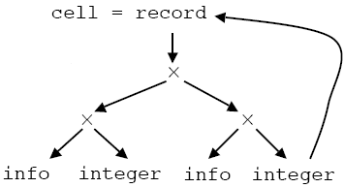
Handling cyclic types
Suppose we had the Pascal declaration
type link = ↑cell;
cell = record
info: integer;
next: link;
end;
The declaration of cell contains itself (via the next pointer).
The graph for this type therefore contains a cycle.
Notes:
lec05-syntaxdirected
January 4, 1980

Slide 76
Cyclic types
The situation in C is slightly different, since it is impossible to refer to an undeclared name.
typedef struct _cell {
int info;
struct _cell *next;
} cell;
typedef *cell link;
But the name link is just shorthand for
(struct _cell *).
C uses name equivalence for structs to avoid recursion
(after expanding typedef’s).
But it uses structural equivalence elsewhere.
Notes:
lec05-syntaxdirected
January 4, 1980

Slide 77
Cycles in Type Expressions
type link = ↑ cell;
type cell = record
x : int,
next : link
end;
We cannot use structural equivalence if there are cycles in type expressions.
We have to treat type names as basic types.
  ➔ but this means that the type expression link is different than the type expression ↑cell.
Compiler Design
Notes:
lec05-syntaxdirected
January 4, 1980
lec06-typechecking
January 4, 1980

Slide 78
Type Conversions
x + y ? what is the type of this expression (int or double)?
What kind of codes we have to produce, if the type of x is double and the type of y is int?
inttoreal y,,t1
real+ t1,x,t2
Compiler Design
Notes:
lec05-syntaxdirected
January 4, 1980
lec06-typechecking
January 4, 1980

Slide 79
Type coercion
If type conversion is done by the compiler without the programmer requesting it, it is called IMPLICIT conversion or type COERCION.
EXPLICIT conversions are those that the programmer
specifices, e.g.
x = (int)y * 2;
Implicit conversion of CONSTANT expressions should be done at compile time.
Notes:
lec05-syntaxdirected
January 4, 1980

Slide 80
Type checking example with coercion
Production Semantic Rule
E -> num E.type := integer
E -> num . num E.type := real
E -> id E.type := lookup( id.entry )
E -> E₁ op E₂ E.type := if E₁.type == integer and E₂.type == integer
then integer
else if E₁.type == integer and E₂.type == real
then real
else if E₁.type == real and E₂.type == integer
then real
else if E₁.type == real and E₂.type == real
then real
else type_error
Notes:
lec05-syntaxdirected
January 4, 1980

